Slide 1
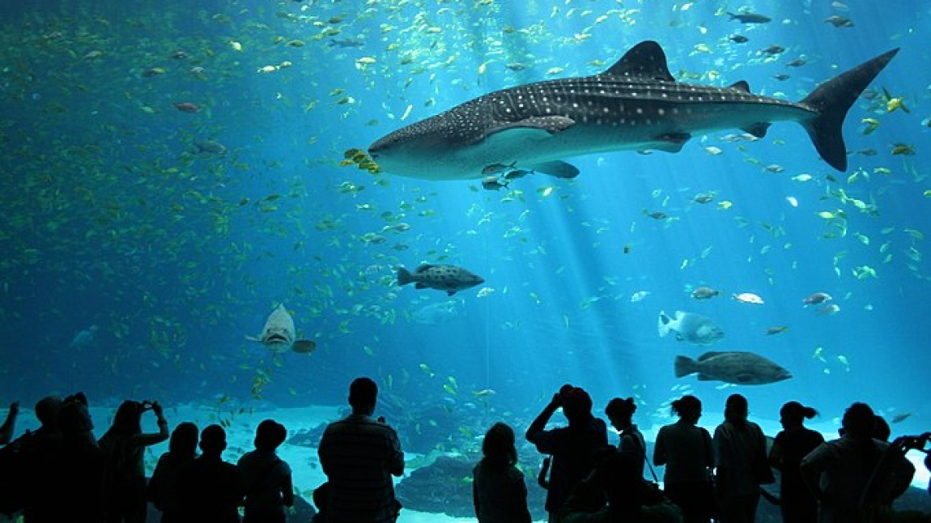
Automated Aquarium Control System * Hüseyin Onur Taştan 2006102015 * Suat Deniz 2006102002

Slide 2
Lighting Control System
Daytime White Light: Operates at 30% power from 06:00-12:00, 0% power from 12:00-18:00, and 50% power from 18:00-21:00.
Nighttime Blue Light: Supports plant growth from 21:00-06:00.
Energy Efficiency: Optimized lighting schedule reduces power consumption.

Slide 3

Temperature and Water Level Control
Temperature Regulation: Activates cooling if temperature exceeds 25°C; heating if below 25°C.
Water Level Monitoring: Triggers pump operation if water level drops below 90%.
Automation Efficiency: Ensures consistent conditions without manual intervention.

Slide 4
Automatic Feeding System
Feeding Schedule: Operates at 00:00, 08:00, and 16:00 daily.
Quantity Calculation: Feeds 3 baits per fish, with 10 bait per session.
Automation Precision: Ensures consistent and timely feeding cycles

Slide 5
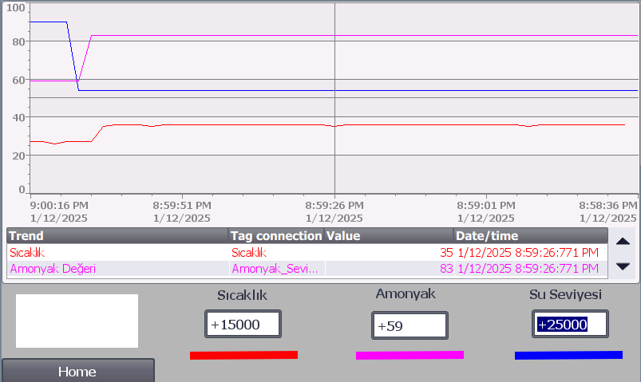
HMI Panel for Live Monitoring graphical
Temperature Tracking: Displays real-time aquarium temperature variations. Graphics
Ammonia Levels: Continuously monitors ammonia concentration for safety.
Water Level Display: Graphical representation of current water levels.

Slide 6

HOME

Slide 7
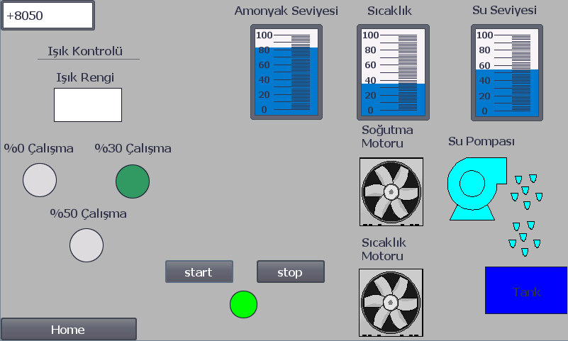
BALIKÇI

Slide 8
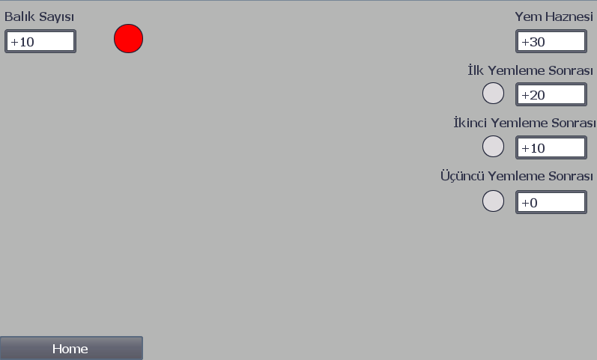
MÜŞTERİ

Slide 9

Startup Initialization Process
Default startıng Ammonıa level is assigned as 83 ppm.
Water Level Setting: Startup water level defaulted to standard safe levels.
Timer Configuration: Default PT time value set to 24.
The total amount of the feed initially assigned as 30.
Temperature Initialization: Default starting temperature set to 36°C.
The number of fish is assigned as 10.

Slide 10

Cyclic Ammonia Monitoring
Monitoring Interval: Ammonia levels are checked every 3 seconds.
Critical Threshold: If ammonia exceeds 85 ppm, alarm light starts flashing.
Safety Protocols: Fish death assumed if threshold is breached, prompting immediate action.

